Slide 1
Mining Change Histories for Unknown Change Patterns
Arvid De Meyer
Promotor: Coen De Roover
Advisor: Reinout Stevens
Notes:
My thesis is about mining change histories for unknown change patterns.

Slide 2
Context Systematic-Repetitive Code Changes
class GeoMath {
double getDistance(Point p1, Point p2) {
return complexStuffOn(p1,p2);
}
double computeDirection (Point o, Point p) {
return complexStuffOn(o,p);
}
}
class CoolClass {
double computeDistance(Point p1, Point p2) {
if(p1.equals(p2)) return 0;
return complexStuffOn(p1,p2);
}
double computeDirection(Point o, Point p) {
if(o.equals(p)) return 0;
return complexStuffOn(o,p);
}
}
Notes:
Software evolutions implies performing changes to source code. In fact, often similar but nonidentical code changes are made to multiple code locations.
Here we have an example, which I will use throughout this presentation. We have some class GeoMath with 2 methods. The first method takes two points p1 and p2 and computes the euclidian distance, the other method computes the angle of the vector connecting both points.
CLICK
Then the developer modifies the source code as shown here. He has renamed the first method to improve consistency but, more importantly, he has modified the body of both methods in an attempt to improve performance: he has inserted a “return zero if both arguments are equal”-statement twice, once at the beginning of each method.

Slide 3
Context Change Patterns
class CoolClass {
double getDistance(Point p1, Point p2) {
return complexStuffOn(p1,p2);
}
double computeDirection (Point o, Point p) {
return complexStuffOn(o,p);
}
}
<return-type> <method-name>(<type1> <param1>, <type2> <param2>) {
<method-body>
}
<return-type> <method-name>(<type1> <param1>, <type2> <param2>) {
if(<param1>.equals(<param2>)) return 0;
<method-body>
}
double <method-name>(Point <var1>, Point <var2>) {
if(<var1>.equals(<var2>)) return 0;
<method-body>
}
class CoolClass {
double computeDistance(Point p1, Point p2) {
if(p1.equals(p2)) return 0;
return complexStuffOn(p1,p2);
}
double computeDirection(Point o, Point p) {
if(o.equals(p)) return 0;
return complexStuffOn(o,p);
}
}
Notes:
Such systematic-repetitive code changes form change patterns. One class of change patterns are refactorings, which are well-known high-level program transformations that preserve behavior but improve program structure. Many approaches to detect refactorings and to automatically refactor code exist.
On the other hand, in the previous slide we have added a return zero if both arguments are equal check to two methods. We can interpret this modification as the change pattern I have visualized here. We start with some method taking two parameters and having some method body, and we finish with a similar method, which has an inserted if-statement at position 0 inside the method body.
This is not some well-known refactoring. However, it still is a program transformation that can automatically be applied to methods that have two formal parameters and that return a numeric value.
My thesis is about mining change histories for such unknown patterns.

Slide 4
Research Training
Data Mining
Representing and Retrieving Changes
Program Transformation Languages
Related Work
Notes:
Before formulating our problem statement in more detail and discussing our approach, I will first fly over the performed research training, which falls apart in 4 topics.
I studied several standard data mining techniques, including frequent episode mining and frequent itemset mining. Another topic relates to representing and retrieving changes made during code evolution. I learned about program transformation languages, which allow retrieving information from source code as well as the transformation of source code. Off course, I also studied closely related work.

Slide 5
Research Training Data Mining
Frequent Substring Mining
Frequent Episode Mining
Sequential Pattern Mining
Frequent Itemset Mining
Notes:
I focussed on several data mining techniques: fsm, fem, spm and fim. In this presentation I will only focus on two of these techniques: frequent episode mining and frequent itemset mining.

Slide 6
Research Training Data Mining: Frequent Episode Mining
Research Training Data Mining: Frequent Episode Mining
A
B
C
D
B
A
C
D
A
B
C
B
A
D
C
D
Frequent episode (support 4)
A,B → C
Mannila, H., Toivonen, H. & Verkamo, A. I. (1997). Discovery of Frequent Episodes in Event Sequences. Data Mining and Knowledge Discovery, 1(3), 259–289.
Notes:
One of the considered standard data mining approaches for mining change patterns is frequent episode mining. In frequent episode mining a single sequence is mined for frequent episodes, which are collections of events occurring relatively close together. Here we have an example sequence.
CLICK
The episode “after the occurrence of both A and B, C occurs” can be found 4 times in this sequence. We say that this episode has support 4.

Slide 7

Research Training Data Mining: Frequent Itemset Mining
Transaction | Items
1 | {Bread, Butter}
2 | {Beer, Milk, Butter}
3 | {Bread, Milk, Butter}
4 | {Beer, Butter}
5 | {Bread, Milk, Butter}
Frequent pattern (support 3)
{Bread, Butter}
Frequent pattern (support 3)
{Bread}
…
Agrawal, R. et al. (1993). Mining Association Rules between Sets of Items in Large Databases. In Proceedings of the 1993 ACM SIGMOD International Conference on Management of Data (pp. 207–216).
Agrawal, R. & Srikant, R. (1994). Fast Algorithms for Mining Association Rules. In Proceedings of the 20th International Conference on Very Large Data Bases (pp. 487–499).
Notes:
Another approach is called frequent itemset mining. It was introduced in the context of market basket analysis for finding products that are frequently bought together. It is built around two kinds of objects: products and baskets. Here we have 4 distinct products, Bread, Butter Milk and Bear. Each of the baskets contains a subset of all products.
In formal terminology baskets are called transactions and products are called items. Sets of items are called itemsets.
CLICK
The aim is to find items that appear frequently together in transactions, called items with a high support. For example, the itemset {Bread, Butter} has a support 3, since it occurs in 3 transactions (1, 3 and 5).
Note that the subitemset {Bread} also has support 3, and thus is frequent too. For this reason we often prefer closed itemsets, itemsets for which there are no superitemsets with the same support.

Slide 8
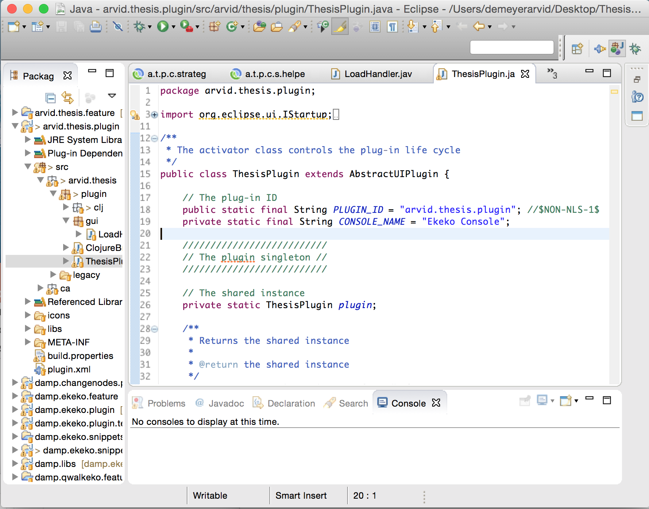
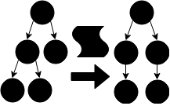
Research Training Representing and retrieving Changes
Notes:
Source code changes can be represented as a script of AST node operations. Such a script lists AST edits (such as the insertion or removal of nodes, the movement of AST subtrees or the replacement of a node or tree by another one).
A first method method for retrieving such a script involves using a change logger, which is an IDE plugin capturing and logging
changes as they are performed by the developer. Another option for retrieving changes, shown at the right, is called change distilling. Here, fine-grained changes are algorithmically inferred based on two source code snapshots.

Slide 9
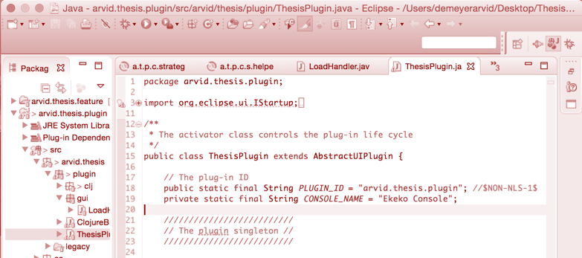
Research Training Representing and retrieving Changes
Change Logging | Change Distilling
 | Algorithmic
Ordered by time | Partial Order by change dependencies
Notes:
Source code changes can be represented as a script of AST node operations. Such a script lists AST edits (such as the insertion or removal of nodes, the movement of AST subtrees or the replacement of a node or tree by another one).
A first method method for retrieving such a script involves using a change logger, which is an IDE plugin capturing and logging
changes as they are performed by the developer. Another option for retrieving changes, shown at the right, is called change distilling. Here, fine-grained changes are algorithmically inferred based on two source code snapshots. This approach of change distilling goes well with version control system data. A VCS stores successive file snapshots, over which changes can be distilled.
LIST CHARACTERISTICS, MORE DETAILS
RELATE TO MINING ALGORITHMS?
change logging is not a common practice, and comes with certain privacy concerns as well (while the use of a VCS is a popular best-practice).
However, the order of changes resulting from change distilling is only partially defined: unlike a change logger, a change distiller does not know the order in which changes were performed by the developer. There only are some guarantees that some changes were performed before other changes. For example, a node can not be moved before its ancestors are inserted.
For this reason, we finally decided on using so-called frequent itemset mining.

Slide 10
Research Training Related Work: Negara et al. (2014)
1 (update, SimpleName, <getDistance()>) = USN
2 (insert, SimpleName, <p1>) = ISN
3 (insert, SimpleName, <equals>) = ISN
4 (insert, SimpleName, <p2>) = ISN
5 (insert, MethodInv, <p1.equals(p2)>) = IMI
6 (insert, NumberLiteral, <0>) = INL
7 (insert, ReturnStatement, <return 0>) = IRS
8 (insert, IfStatement, <if (…) …>) = IIS
… … = …
Negara, S. et al. (2014). Mining Fine-grained Code Changes to Detect Unknown Change Patterns. In Proceedings of the 36th International Conference on Software Engineering (ICSE) (pp. 803–813). May 31 - June 07, 2014, Hyderabad, IN.
Notes:
The original thesis proposal is based on a paper called “Mining Fine-Grained Code Changes to Detect Unknown Change Patterns”. While most earlier work mainly focusses on well-known change patterns such as refactorings this paper presents a mining algorithm to find previously unknown often-used program transformations.
To this extend, they use a change logger, capturing changes as they are performed by developers. Here we see a partial output of what a change logger would emit while a developer is changing the code as shown in the first slide. To avoid making pattern too specific, the algorithm ignores the contents of changed AST nodes: it only considers the type of change and the kind of AST node. For example, the sixth line, resulting from inserting a literal number 0 is generalized to “insertion of any number literal”, here abbreviated to INL.

Slide 11
Research Training Related Work: Negara et al. (2014)
USN ASN ASN ASN AMI ANL ARS AIS …
USN ASN ASN ASN AMI ANL ARS AIS …
USN ASN ASN ASN AMI ANL ARS AIS …
USN ASN ASN ASN AMI ANL ARS AIS …
time
Notes:
They divide the input sequence of generalized logged changes into partially overlapping bags of changes on which a variant of standard frequent itemset mining is performed.
Here we see the logged change sequence horizontally, and I have chosen a fixed transaction size of 4, which will only detect patterns up to size 2, so it will not detect the “return if arguments are equal” pattern of size 7. The real algorithm uses windows of variable size, based on time: for example: a window corresponds to 5 minutes of code changes…

Slide 12




Research Training Related Work: Negara et al. (2014)
Notes:
Just like my “return zero if both arguments are equal” pattern they discovered 10 kinds of popular high-level program transformations
But the work discussed in the paper has two important limitations.
First, as already mentioned, change logging is not a common practice, and comes with certain privacy concerns as well (while the use of a VCS is a popular best-practice).
Second, due to the very extensive generalization resulting from only considering the kind of operation and the type of ast node, many patterns are found, of which most are not actual change patterns: After itemset mining, manual investigation was necessary to identify which of the provided patterns were in fact actual change patterns. Also, The extensive generalization makes automatic transformation of new code according to mined patterns impossible. Stated informally, too much information is thrown away.
For this reason, I will use change distilling instead of change logging. Furthermore I will focus on mining automatable patterns, which are code change patterns that can automatically be applied to source code, transforming the code systematically according to the change pattern.

Slide 13
Problem Statement
“In this thesis, we formulate the problem of finding previously unknown automatable change patterns in the history of software projects as a data mining problem.
More concretely, we apply the frequent itemset mining algorithm, operating on the changes between two successive VCS snapshots, looking for change patterns in open-source software repositories provided by GitHub.”
Notes:
This brings us to our problem statement. In this thesis we focus on finding previously unknown change patterns. To this purpose we will use standard data mining techniques operating on changes made between successive VCS snapshots.
More concretely, we apply the frequent itemset mining algorithm, operating on the changes between two successive VCS snapshots, looking for change patterns in open-source software repositories provided by GitHub.

Slide 14

Approach
Notes:
So, here we have an outline of my approach, in the next slides I will discuss each step in greater detail.
So, in our approach we collect data by comparing successive version control snapshots.
1/ Concretely, we start with a software history contained in a VCS repository.
2/ Secondly, we distill changes make between successive VCS commits.
3/ Thirdly, we then preprocess the distilled changes in the form of grouping and generalization
4/ This then allows us to apply a data mining algorithm
5/ Discovered change patterns can then be used to automate the transformation of new code according to the change pattern

Slide 15
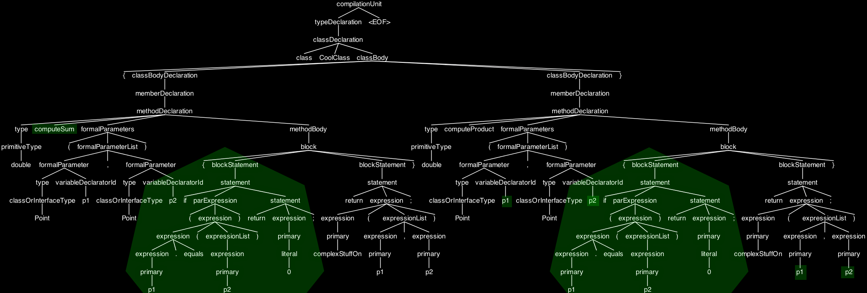
Approach Change Distilling
(update, <SimpleName, getDistance>)
(add, <SimpleName, o>)
(add, <SimpleName, equals>)
(add, <SimpleName, p>)
(add, <MethodInv, o.equals(p)>
(add, <NumberLiteral, 0>)
(add, <ReturnStatement, return 0>)
(add, <IfStatement,<if (…) …>)
(add, <SimpleName, p1>)
(add, <SimpleName, equals>)
(add, <SimpleName, p2>)
(add, <MethodInv, p1.equals(p2)>
(add, <NumberLiteral, 0>)
(add, <ReturnStatement, return 0>)
(add, <IfStatement, if (…) …>)
Beat, F. et al. (2007). Change Distilling: Tree Differencing for Fine-Grained Source Code Change Extraction. In IEEE Transactions on Software Engineering (pp. 725–743).
Notes:
Instead of using change logging, we use change distilling.
So, in order to discover changes between successive VCS commits, consider the abstract syntax tree corresponding with the second version of my example. I have highlighted code changes and additions which were performed to the original version: we have the rename of the method and we have the insertion of our “return zero if arguments are equal” statement, which occurres twice.
A change distiller provides us the information that we see here: it reports AST node insertions, updates, removals and moves. As already mentioned, An important observation is that the order in which changes are reported is only partially defined: a change distiller can not determine in which order the changes were performed by the developer.

Slide 16
Approach Preprocessing: Grouping
Group | Changes
getDistance() | (update, <SimpleName, getDistance>) (add, <SimpleName, p1>) (add, <SimpleName, equals>) (add, <SimpleName, p2>) (add, <MethodInv, p1.equals(p2)>) (add, <NumberLiteral, 0>) (add, <ReturnStatement, return 0>) (add, <IfStatement, if (…) …>)
computeDirection() | (add, <SimpleName, o>) (add, <SimpleName, equals>) (add, <SimpleName, p>) (add, <MethodInv, o.equals(p)>) (add, <NumberLiteral, 0>) (add, <ReturnStatement, return 0>) (add, <IfStatement, if (…) …>)
Notes:
In order to enable data mining using frequent itemset mining a transaction database should be built. To this extend we have introduced a preprocessing step, which groups and generalizes the changes in the sequence of distilled changes. Let’s first discuss change grouping.
Since the order of distilled changes is only partially defined, we group changes by the subtree in which they occur rooted at a specific type of node. For example, here I have shown grouping at the method level. This results in two groups, one containing the changes performed within each method.
The grouping granularity directly impacts the maximal size of minable patterns. Grouping at a statement level does for example not allow the detection of patterns consisting of multiple statements, and grouping at a method level makes it impossible to find patterns containing class field renames or the insertion of new methods.

Slide 17
Approach Preprocessing: Equivalence Relation over Changes
Notes:
TODO: Introduce equiv rel, then go to next slide
+ tell requirements, play with it: ex, if I take x away I will …

Slide 18
Approach Preprocessing: Generalization
(update, #<SimpleName, …>)
(add, #<SimpleName, …>)
(add, #<SimpleName, …>)
(add, #<SimpleName, …>)
(add, #<MethodInv, ….…(…) >)
(add, #<NumberLiteral, …>)
(add, #<ReturnStatement, return …>)
(add, #<IfStatement, if (…) …>)
(add, #<SimpleName, …>)
(add, #<SimpleName, …>)
(add, #<SimpleName, …>)
(add, #<MethodInv, …….(...)>)
(add, #<NumberLiteral, …>)
(add, #<ReturnStatement, return …>)
(add, #<IfStatement, if (…) …>)
Required commonalities:
- Same operation
- At same location in group
- Involving structurally equal subtrees
Notes:
When looking for changes patterns one central question is: when are two changes the same, and when do they differ? For this reason, we also introduce change generalization, by means of defining an equivlalence relation over changes, considering certain changes equivalent if and only if they share certain commonalities.
Here I have chosen to generalize the changes in such a way that they are considered equal if the same operation is performed at the same location in its group on AST subtrees which are structurally equal (i.e. they have the same structure, but simple values are ignored).
In the thesis we studied and evuated several alternative ways of both grouping and equivalence relations, and discussed requirements to yield valid results.

Slide 19
Approach Frequent Itemset Mining
Transaction | Contents
1 | (update, #<SimpleName, …>) (add, #<SimpleName, …>) (add, #<SimpleName, …>) (add, #<SimpleName, …>) (add, #<MethodInv, …….(...)>) (add, #<NumberLiteral, …>) (add, #<ReturnStatement, return …>) (add, #<IfStatement, if (…) …>)
2 | (add, #<SimpleName, …>) (add, #<SimpleName, …>) (add, #<SimpleName, …>) (add, #<MethodInv, ….…(…) >) (add, #<NumberLiteral, …>) (add, #<ReturnStatement, return …>) (add, #<IfStatement, if (…) …>)
Frequent pattern (support=2)
(add, #<SimpleName, …>)
(add, #<SimpleName, …>)
(add, #<SimpleName, …>)
(add, #<MethodInv, …….(...)>)
(add, #<NumberLiteral, …>)
(add, #<ReturnStatement, return …>)
(add, #<IfStatement, if (…) …>)
Notes:
After grouping and generalization of the changes we can form what is called a database, on which we can launch an algorithm for frequent itemset mining.
Basically, we convert each group we formed into a transaction, so in the example we had formed two groups, one for each method, and we thus have a transaction database with two transaction. Each transaction itself is the set of all generalized changes occurring within the corresponding group.
The set of generalized changes to the right has support 2 since it occurs in both transactions to the left. Intuitively, this pattern corresponds to the insertion of an if-statement at the first position in a method’s body.
Such a set of generalized changes is called a change pattern. Although technically it is nothing more than a set of generalized changes, such a set contains sufficient information to allow automatical inference of code locations to which a pattern can be applied or to automate the trnasformation of source code.

Slide 20
Approach Towards Automating Change Patterns
Notes:
Discuss LHS, RHS focus LHS

Slide 21
Implementation
Implementation Platform & Language | Eclipse, Clojure
Target VCS & Language | Git, Java
Change Distilling | ChangeNodes
Data Mining | SPMF’s CHARM implementation
Program Transformation Language | Ekeko/X
De Roover, C. & Stevens, R. (2014). Building Development Tools Interactively Using the Ekeko Meta-Programming Library. In R. Demeyer, D. Binkley & F. Ricca (Eds.), Proceedings of the IEEE Conference on Software Maintenance, Reengineering and Reverse Engineering (CSMR-WCRE), 2014 Software Evolution Week (pp. 429–433). February 3–6, 2014, Antwerp, BE.
De Roover, C. & Inoue, K. (2014). The Ekeko/X Program Transformation Tool. In Proceedings of the 14th IEEE International Working Conference on Source Code Analysis and manipulation). September 28–29, 2014, Victoria, British Columbia, CA.
Andersen, J. & Lawall, J. (2008). Generic Patch Inference. In 23rd IEEE/ACM International Conference on Automated Software Engineering (pp. 337–346).
Notes:
We implemented the mining algorithm as an Eclipse plugin, usable via the Clojure REPL. Git is used as a source of VCS data, using the JGIT library.
As differencing tool we use ChangeNodes, developed here at the VUB. ChangeNodes is an adaptation of the algorithm implemented in the well-known tool ChangeDistiller, it is very similar but it uses language-aware JDT-nodes instead of a language-agnostic AST representation. Furthermore, it integrates with the program querying tool Ekeko, whose facilities are used throughout the entire implementation.
Since even simple code modifications quickly result in many code changes, an advanced highly-performant algorithm for closed frequent itemset mining called CHARM is used. Instead of implementing this algorithm from scratch, we use an open-source Java data mining library called SPMF. SPMF provides a uniform interface to a large variety of data mining algorithms.
We construct Ekeko/X templates to allow querying other source code for candidate transformation subjects. Ekeko/X is a template-driven program transformation tool implemented on top of the meta-programming library Ekeko. It allows specifying code fragment characteristics by means of code templates, after which new source code can be queried for code fragments matching the specified characteristics.

Slide 22
Evaluation
RQ1 (Recall Known): can the approach recall known change patterns?
RQ2 (Find Unknown): how does the approach perform on open-source projects?
Notes:
In the evaluation of our approach we answered two research question.
The first one is: ..., the second one is ...

Slide 23
Evaluation: Exapus
Motivation
Familiarity ☺
Many systematic-repetitive changes ☺
Size
263 commits
13198 java LOC over 129 files
Notes:
All experiments were performed on the history of the Exapus project, developed here at the VUB. We have chosen Exapus due to familiarity with the project and the knowledge that many systematic-repetitive changes were made during development.
At time of writing the project’s git repository contains 263 commits made by 3 authors between October 5th, 2012 and April 2nd, 2014. The last commit contains 189 files, of which 156 are text files together containing 17240 lines of code. Of these text files, 129 files together containing 13198 lines of code are java source code files.

Slide 24
Evaluation: Recalling Known Patterns
Given relatively small code fragments with known systematic-repetitive changes
The algorithm is able to recall the change patterns, with performance highly dependent on the used grouping granularity and equivalence relation
Notes:
To answer the first question we applied the algorithm to a set of 4 relatively small Exapus code fragments with known systematic-repetitive changes. For each code fragment, we first identified intuitively which change pattern(s) are present. Mined change patterns were then verified manually by comparison with the change patterns present intuitively, calculating precision and recall.
I will give an example soon, but to conclude the algorithm is able to recall the change patterns, with performance highly dependent on the used grouping granularity and equivalence relation .

Slide 25
Evaluation: Recalling Known Patterns, Example
package exapus.gui.views.forest;
import org.eclipse.jface.viewers.ITreeContentProvider;
... [6 more]
import exapus.model.forest.DeltaEvent;
import exapus.model.forest.FactForest;
import exapus.model.forest.ForestElement;
import exapus.model.forest.IDeltaListener;
import exapus.model.forest.Member;
import exapus.model.forest.MemberContainer;
import exapus.model.forest.PackageLayer;
import exapus.model.forest.PackageTree;
import exapus.model.forest.Ref;
public class FactForestTreeContentProvider ... {
...
import exapus.model.<simpleName>;
import exapus.model.forest.<simpleName>;
Notes:
SHOULD GIVE EXAMPLE, EXPLAIN IT COMPLETELY
To illustrate our conclusion, I will explain one very simple but rather interesting small code fragment here. This example also helps to get more insight in the impact of grouping and generalization..
So, We have a file with 16 import declarations, and due to the movement of several files to a subpackage 9 imprt-declarations were modified as shown here.
Intuitively, the corresponding change pattern involves changing qualifiers exapus.model of names of import declarations to exapus.model.forest.

Slide 26
Evaluation: Recalling Known Patterns, Example
ImportDeclaration
Import exapus.model.DeltaEvent
package exapus.gui.views.forest;
import org.eclipse.jface.viewers.ITreeContentProvider;
... [6 more]
import exapus.model.forest.DeltaEvent;
import exapus.model.forest.FactForest;
import exapus.model.forest.ForestElement;
import exapus.model.forest.IDeltaListener;
import exapus.model.forest.Member;
import exapus.model.forest.MemberContainer;
import exapus.model.forest..PackageLayer;
import exapus.model.forest.PackageTree;
import exapus.model.forest.Ref;
public class FactForestTreeContentProvider ... {
...
name
onDemand
QualifiedName
exapus.model.DeltaEvent
Boolean
false
qualifier
name
QualifiedName
exapus.model
SimpleName
DeltaEvent
qualifier
name
identifier
SimpleName
exapus
SimpleName
model
String
DeltaEvent
identifier
identifier
String
exapus
String
model
Notes:
For illustrative purposes, Figure 7.1 shows the underlying source AST structure of the first modified import declaration. An ImportDeclaration has a structural property name whose value is a Name, i.e. a SimpleName or a QualifiedName. A QualifiedName is of the form qualifier.name with structural property qualifier another Name and structural property name a SimpleName. As such, differencing source AST and target AST of the compilation unit under investigation results in 9 changes, one insert for each import declaration, representing the insertion of the QualifiedName exapus.model.forest in structural property qualifier of the structural property name the import declaration.

Slide 27
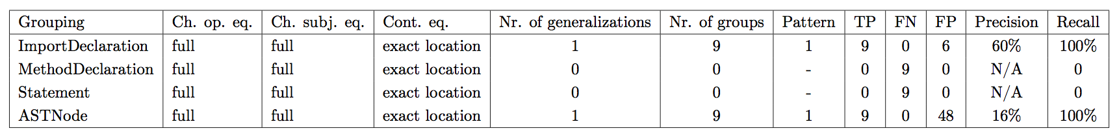
Evaluation: Recalling Known Patterns, Example
package exapus.gui.views.forest;
import org.eclipse.jface.viewers.ITreeContentProvider;
... [6 more]
import exapus.model.forest.DeltaEvent;
import exapus.model.forest.FactForest;
import exapus.model.forest.ForestElement;
import exapus.model.forest.IDeltaListener;
import exapus.model.forest.Member;
import exapus.model.forest.MemberContainer;
import exapus.model.forest.PackageLayer;
import exapus.model.forest.PackageTree;
import exapus.model.forest.Ref;
public class FactForestTreeContentProvider ... {
...
Notes:
Results are given in Table 7.1. First of all, note that no pattern can be detected when grouping at a Statement or MethodDeclaration granularity, no matter which equivalence relation is used. Indeed, import declarations are not statements, nor are they wrapped inside a method declaration. As a result, grouping at Statement or MethodDeclaration granularity results in one group with group container undefined, containing all changes. Due to the absence of a group container, the mining algorithm does not consider changes in this group. To conclude, under both configurations there are 9 false negatives, 0 true positives and 0 false positives with respect to the intuitive pattern, resulting in a undefined precision (division by zero) and zero recall.
Grouping changes at an ASTNode granularity using the same equivalence relation yields another change pattern “insert of QualifiedName exapus.model.forest at structural
property qualifier of any type of ASTNode having this structural property (e.g. Qual- ifiedName, NameQualifiedType) ”. Note that this change pattern can be applied to all QualifiedName’s, including nested ones. The compilation unit under investigation contains 57 of such nodes. To conclude, there are 0 false negatives, 9 true positives and 48 false positives with respect to the intuitive pattern, resulting in a recall of 9/(9 + 0) = 100% and a precision of 9/(9 + 48) = 16%.
Grouping changes at an ImportDeclaration granularity, using a full change oper- ation equality, full change subject equality and exact location contextual equality yields the change pattern “insert of QualifiedName exapus.model.forest at position [:name :qualifier] in ImportDeclarations” with support 9. As such, the pattern can be applied at all AST nodes that are ImportDeclarations with their name being a QualifiedName. This includes all 15 import declarations in the source AST; for ex- ample, the pattern can be applied to import com.google.common.collect.Iterables;, resulting in import exapus.model.forest.Iterables;. Thus, the pattern can be ap- plied to 15 AST nodes, where the intuitive change pattern could only be applied to 9 AST nodes. To conclude, there are 0 false negatives, 9 true positives and 6 false positives with respect to the intuitive pattern, resulting in a recall of 9/(9 + 0) = 100% and a precision of 9/(9 + 6) = 60%.
The poor precision even when grouping at an ImportDeclaration granularity is the result of ChangeNodes reporting insert-operations instead of update-operations: as seen in Chapter 3 update-operations are only emitted when replacing the value of simple property values, which the qualifier of a QualifiedName is not. An equality- definition taking into consideration characteristics of the overwritten source AST node of insert-operations would improve precision to 100%.

Slide 28
Evaluation: Performance on Open-Source Projects
Distilled 22670 changes
Grouping at MethodDeclaration granularity, Generalizing structurally on change subject
Mined 403 change patterns (< 10 min)
Notes:
We analyzed performance of the approach on the entire history of open-source projects, i.e. we have determined its ability to derive useful previously unknown change patterns given a large database of code and code changes.
Given the entire exapus git repository, we distilled more than 22000 changes, from which we derived more than 400 patterns.

Slide 29
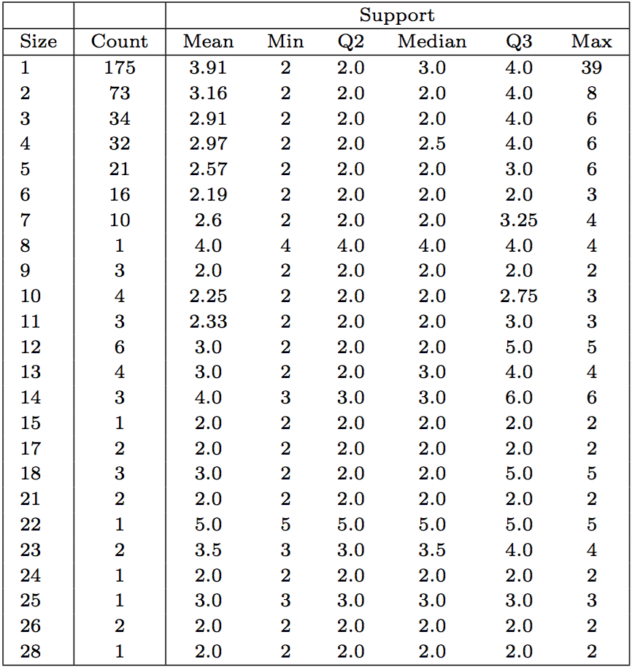
Evaluation: Performance on Open-Source Projects
Notes:
Here I’ve listed pattern size in function of pattern support (the number of times the patterns occurs in the source code). Clearly, pattern size tends to decrease with increasing support: the more complex change patterns are, the less frequent they occur. Furthermore, many patterns with a pattern size of 1 exist. Such patterns involve very simple operations such as changing a SimpleValue’s identifier. Based on these observations and due to the size of the mining result, we ordered mined change patterns by frequency times size. We then investigated results manually, starting from the top of the list. Investigated change patterns did correspond with systematic-repetitive high-level program transformations.

Slide 30
Conclusion
Mining Automatable Patterns
RQ1 (Recall Known): can the approach recall known change patterns?
RQ2 (Find Unknown): how does the approach perform on open-source projects?
Notes:
We presented an approach for mining VCS histories for previously-unknown, automatable change patterns. More concretely, we apply a standard data mining technique called frequent itemset mining, operating on the changes between two successive VCS snapshots, looking for change patterns in open-source software repositories provided by GitHub
In our evaluation we have answered two research questions. Primo, we focussed on the performance of the approach to recall known change patterns given small code fragments with known systematic-repetitive changes, which resulted in a performance highly dependend on the used grouping granularity and equivalence relation.
Secundo, we focussed on performance on open-source projects by applying our approach under a specific configuration on the entire history of an open-source project. Due to the size of the mining result and the dominance of relatively small change patterns occurring often, we sorted change patterns by size times support. We investigated the top of the list, all investigated mined change patterns did correspond with systematic-repetitive high-level program transformations.

Slide 31
Future Work
Improving tool support
Exploration of other languages, VCSs and change distillers
Towards Change Pattern Taxonomies
Notes:
We have presented a method for finding new source code fragments to which change patterns can be applied. However, although we focus on automatable change patterns in this work, developers still have to manually transform identified code fragments. A first line of future work involves improving tool support, enabling the automatic systematic transformation of source code according to mined change patterns.
In order to achieve a reduction of engineering effort, we have only implemented the mining of git repositories for change patterns from distilled changenodes changes in Java source code. Future work can cover other VCSs (e.g. Apache SVN, CVS), programming languages and change distillers
Finally, A third line of future works relates to a further study of mined change patterns, classif ing systematic-repetitive changes and investigating their popularity on a cross-project basis. This helps scientists to get a better understanding of how code evolves and allows IDE developers and tool builders to provide built-in functionality to automate popular transformations beyond well-known refactorings.
But I guess all this will be for another student...

